Slide 2
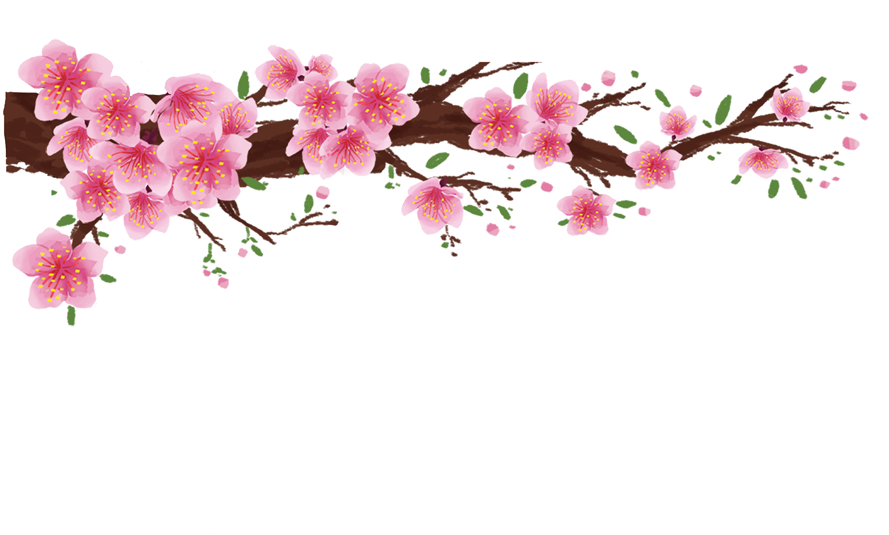

Slide 3
Listening
Writing
Nguyen is writing to his penfriend Tom about how his family prepares for Tet. Listen and tick () the things you hear.
Work in groups. Discuss and make a list of four things that you think children should and shouldn’t do at Tet.
Listen again and answer the questions in one or two words.
Complete the email, using your ideas in 3.

Slide 4
Listening

Slide 5
Nguyen is writing to his penfriend Tom about how his family prepares for Tet. Listen and tick () the things you hear.
1.
old things

2.
peach flowers

3.
new clothes

4.
cakes
5.
wishes

6.
good luck
Audio script

Slide 6
AUDIO SCRIPT
Dear Tom,
Tet is coming and I’m very happy. We do a lot of things before Tet. We throw some old things away. We clean and decorate our homes. My mother goes shopping and buys food, red envelopes, and peach flowers. She also buys new clothes for us. My father makes banh chung and cooks them on an open fire. He says that I should make some wishes at Tet, and I shouldn’t break anything. It brings bad luck.
Yours Nguyen

Slide 7
Listen again and answer the questions in one or two words.
1.
What do they throw away before Tet?
Old things.
2.
What do they clean and decorate?
(Their) houses.
3.
What colour are the envelopes?
Red.
4.
Who cooks banh chung?
(His) father.
5.
What shouldn’t they break?
Anything.
Audio script

Slide 8
AUDIO SCRIPT
Dear Tom,
Tet is coming and I’m very happy. We do a lot of things before Tet. We throw some old things away. We clean and decorate our homes. My mother goes shopping and buys food, red envelopes, and peach flowers. She also buys new clothes for us. My father makes banh chung and cooks them on an open fire. He says that I should make some wishes at Tet, and I shouldn’t break anything. It brings bad luck.
Yours Nguyen

Slide 9
Writing

Slide 10
Work in groups. Discuss and make a list of four things that you think children should and shouldn’t do at Tet.
Children should
1.
2.
Children shouldn’t
3.
4.

Slide 11
Complete the email, using your ideas in 3.
To: tom@webmail.com
Subject: Tet in Viet Nam
Dear Tom,
Tet is coming. I will tell you more about our Tet.
At Tet, we should
We should
But we shouldn’t
We shouldn’t
Please write and tell me about your New Year celebration.
Yours,
Nguyen
.
, too.
.
, either.

Slide 12
Complete the email, using your ideas in 3.
To: tom@webmail.com
Subject: Tet in Viet Nam
Dear Tom,
Tet is coming. I will tell you more about our Tet.
At Tet, we should decorate our homes with flowers and plants.
We should visit our grandparents and relatives, too.
But we shouldn’t eat too much sweet food.
We shouldn’t keep lucky money, either. We should put into our piggy bank.
Please write and tell me about your New Year celebration.
Yours,
Nguyen

