Slide 1
Festival around the world
Unit 9:
Lesson 1:
GETTING STARTED

Slide 2
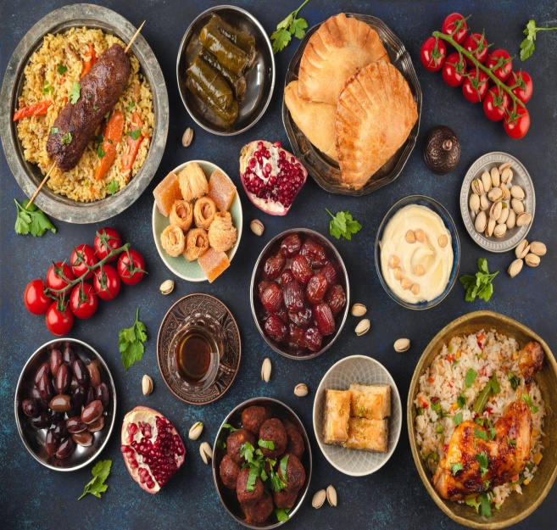
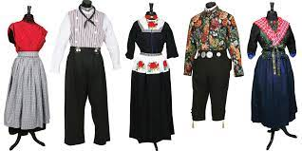
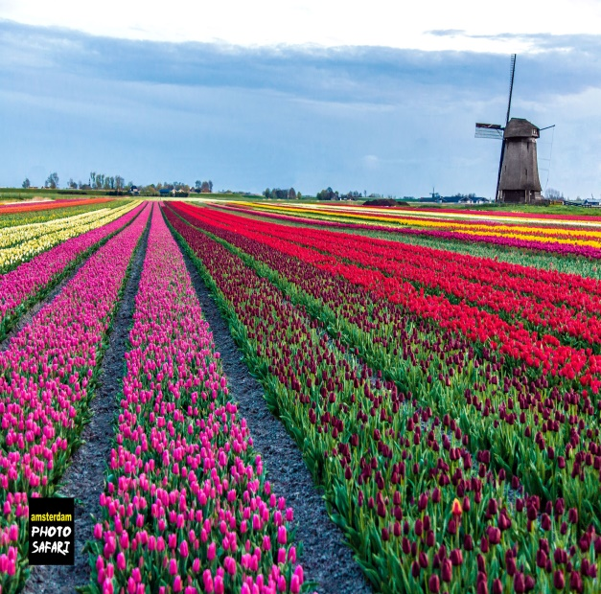
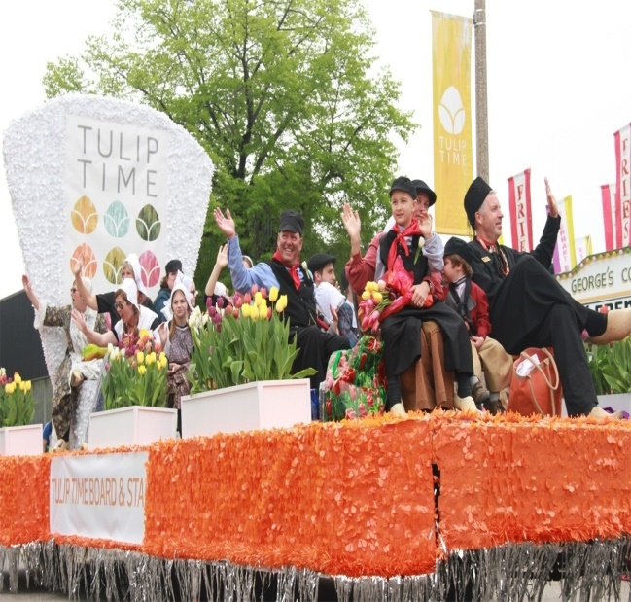
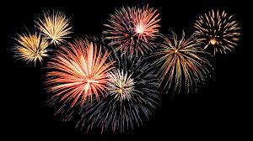
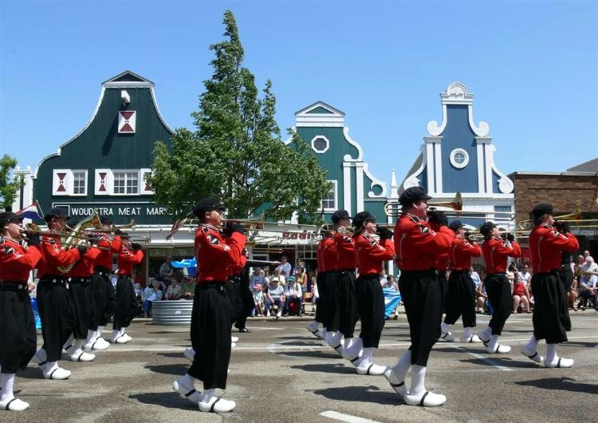
Warm up
Guessing game
1
2
3
4
5
6

Slide 3
Festival around the world
Unit 9:
Lesson 1:
GETTING STARTED
A tulip festival

Slide 4
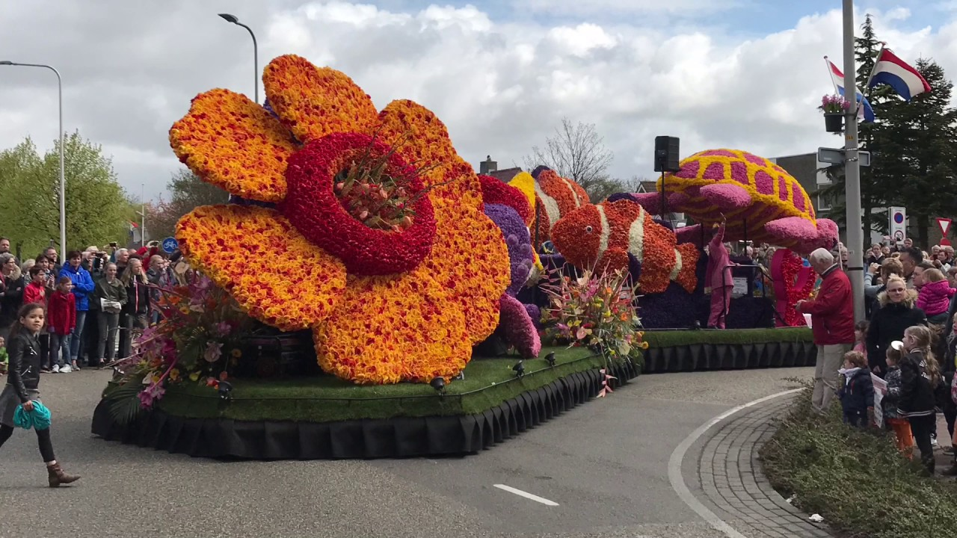
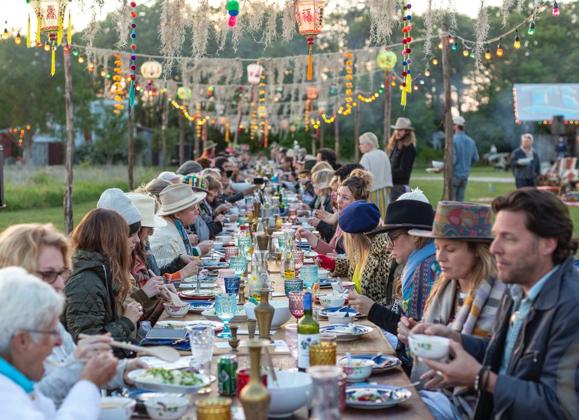
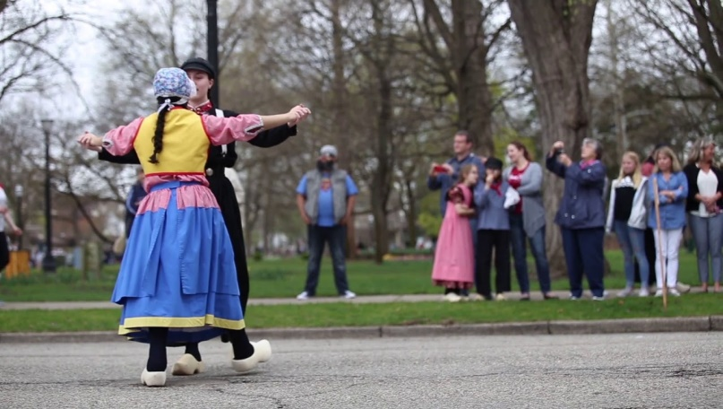
Vocabulary
costume /ˈkɒs.tjuːm/
folk dance /fəʊk dɑːnts/
feast /fiːst/
parade /pəˈreɪd/
firework display/ˈfaɪə.wɜːk dɪˈspleɪ/
float /fləʊt/

Slide 5
Vocabulary
tulip/ˈtjuː.lɪp/ : hoa tulip (uất kim hương)
costume /ˈkɒs.tjuːm/ : trang phục
folk dance /fəʊk dɑːnts/ : dân vũ/ điệu nhảy dân gian
feast /fiːst/: bữa tiệc
parade /pəˈreɪd/ : cuộc diễu hành
firework display/ˈfaɪə.wɜːk dɪˈspleɪ/ : bắn pháo hoa
float /fləʊt/ : xe diễu hành

Slide 6
Listen and read
 | Ms Hoa | Mark
1. Went to the Tulip festival in Australia
2. Went to the Tulip Festival in the Netherland
3. Tried Dutch food and drinks
4. Watched traditional Dutch dancing
5. Saw tulip floats
Read and tick

Slide 7
2. Listen and read
Mark and Trang: Good afternoon Ms. Hoa
Ms.Hoa: Oh, hi. Come in.
Trang: Wow. This is a nice cozy room, Ms.Hoa. I like the photos on the wall. I can see you among all those tulips. Where did you take the photos?
Ms.Hoa: I took them at the Tulip Festival in Australia last September.
Mark: Really? I went to a tulip festival two years ago but it was in Netherlands. It was the Dutch Tulip Festival.
Trang: What did you do at the festival?
Ms.Hoa: I watched Dutch folk dances. The dancers wore traditional costumes. I also got a chance to try some delicious Dutch food and drinks. I also saw beautiful tulip floats at a parade.
Trang: Do they hold the festival every year in Australia?
Ms.Hoa: Yes, they do.

Slide 8
2. Read the conversation and tick
 | Ms Hoa | Mark
1. Went to the Tulip festival in Australia
2. Went to the Tulip Festival in the Netherland
3. Tried Dutch food and drinks
4. Watched traditional Dutch dancing
5. Saw tulip floats
Read and tick
√
√
√
√
√
√

Slide 9
3. Write a word or phrase from the box under each picture.
costumes feast float fireworks display parade folk dance
1. ________
2. ________
3._________
parade
costumes
feast
4._________
5._______________
6._________
float
fireworks display
folk dance

Slide 10
4. Fill in each blank with a word or phrase from 3
1. The dancers performed ___________ at the Tulip Festival.
2. On New Year’s Eve, we went to Hoan Kiem Lake to watch the ______________.
3. For Tet, we usually prepare a ___________ with special food.
4. People hold flower ___________ in several countries to welcome the new season.
5. The _________ carried the dancers in special ___________.
folk dances
fireworks display
feast
parades
floats
costumes

Slide 11
Quiz
What festival is it? Match each description with a festival.
1. At this festival, people eat moon cakes. |  | a. La Tomatina
2. At this festival, people throw tomatoes. |  | b. Cheese rolling
3. People eat banh chung at this festival. |  | c. Christmas
4. People decorate pine trees and give each other gifts. |  | d. Tet
5. People chase after a wheel of cheese. |  | e. Mid-Autumn Festival
1-e
2-a
3-d
4-c
5-b

Slide 12
Homework
Learn vocabulary
Practice the conversation
Name at least three festivals you know
Prepare for A closer look 2

