Slide 1
…………………., 2023
UNIT 7: TRAFFIC
Period: 56 – Lesson 2: A closer Look 1
I. Pre- stage
II. During- stage
III. Post- stage
IV. Wrap -up
V. Homework

Slide 2
I. Pre- stage
1. WARM-UP: JUMBLED WORDS
MEANS OF TRANSPORT
-> BOAT
1- OTBA
2- ITANR
3- NPEILARA
4- RSOTRPCA
5- OTMIROEKB
-> TRAIN
-> AIRPLANE
-> SPORT CAR
-> MOTORBIKE

Slide 3
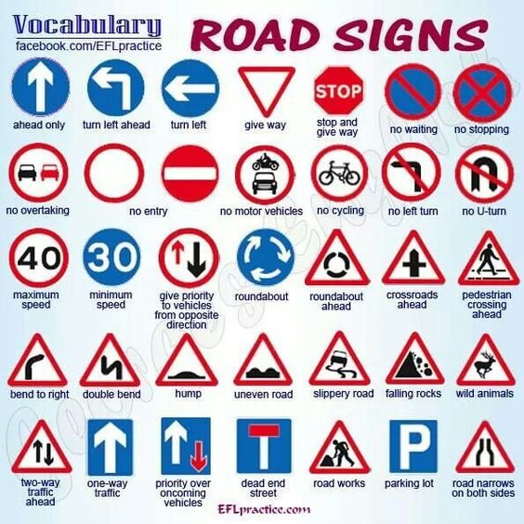
A. Vocabulary
road sign (n)
/ˈrəʊd saɪn/
biển báo giao thông

Slide 4
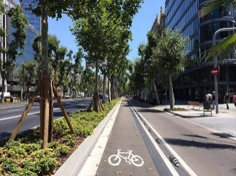
1. Vocabulary
cycle lane (n)
/ˈsaɪkl leɪn/
làn đường dành riêng cho xe đạp

Slide 5
2. Vocabulary
traffic light (n.phr.)
/ˈtræfɪk laɪt/
đèn giao thông

Slide 6
2. Vocabulary
No right turn :
Cấm rẽ phải

Slide 7
2. Vocabulary
No cycling:
Cấm đi xe đạp

Slide 8
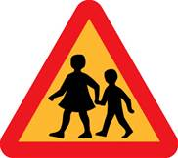
2. Vocabulary
School ahead :
Phía trước là trường học

Slide 9
3. Check Vocabulary: Matching ( đây chính là bài tập 2 SGK)

Slide 10
No right turn
Parking
Traffic lights
Cycle lane
No cycling
Hospital ahead
School ahead
1.
.
2.
3.
Trafic lights
No right turn
Hospital ahead
4.
5.
6.
Cycle lane
School ahead
No cycling

Slide 11
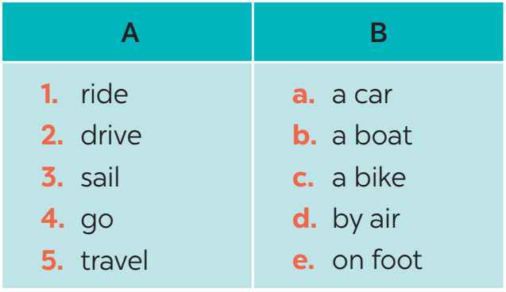
II. During-stage
Activity 1: Match the words in A with the phrases in B.

Slide 12
Activity 3: Work in pairs. Take turns to say which of the signs in 2 you see on the way to school.
A
B

Slide 13
Activity 3: Work in pairs. Take turns to say which of the signs in 2 you see on the way to school.
A: On the way to school, there are crossroads, so I see several traffic lights
B: On my way to school, there is a hospital, so I see a hospital ahead sign.
A
B

Slide 14
Discuss which of the signs you see on the way to school.
A: On the way to school, I can see a “no right turn” sign.
B: On my way to school there is a hospital, so I can see a “hospital ahead” sign.

Slide 15
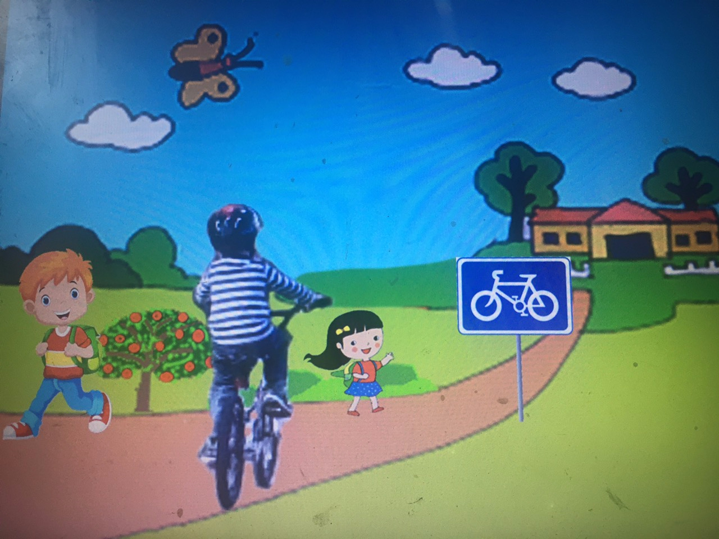
On the way to school, I can see a “cycle lane” sign.

Slide 16
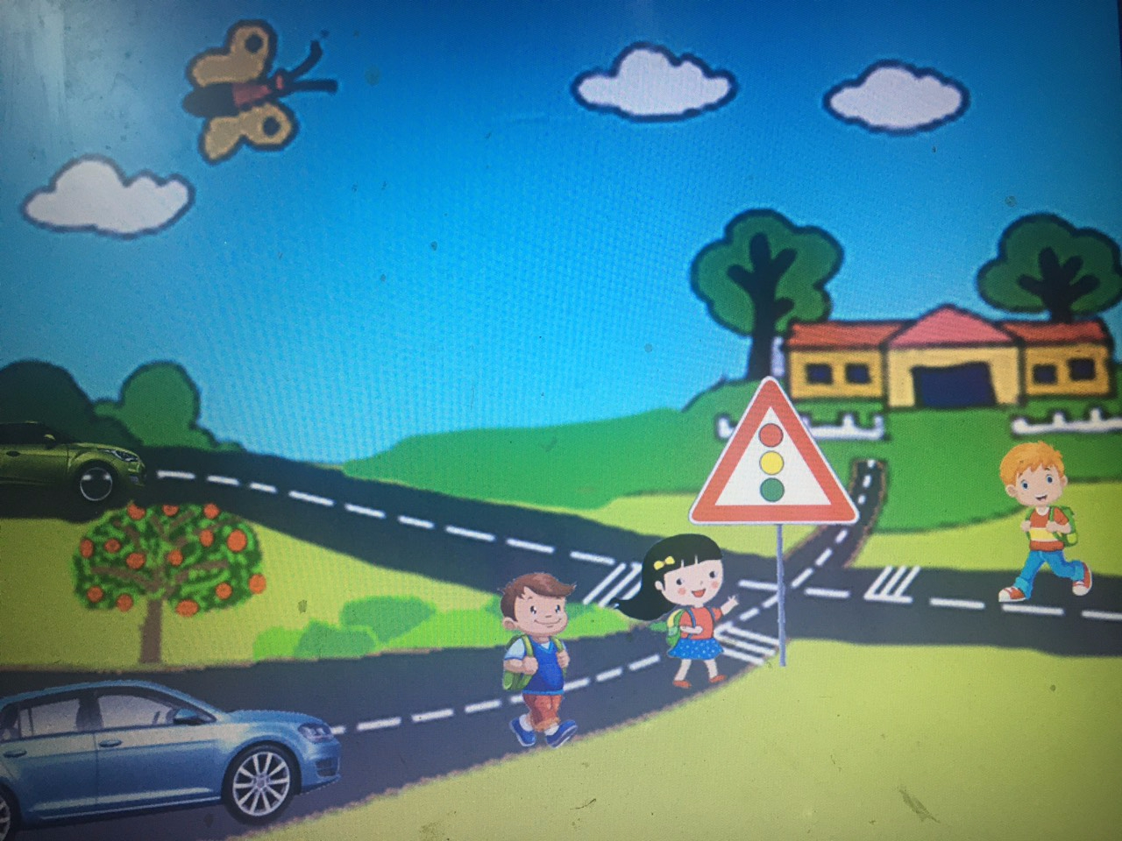
On the way to school, I can see a “traffic light” sign.

Slide 17
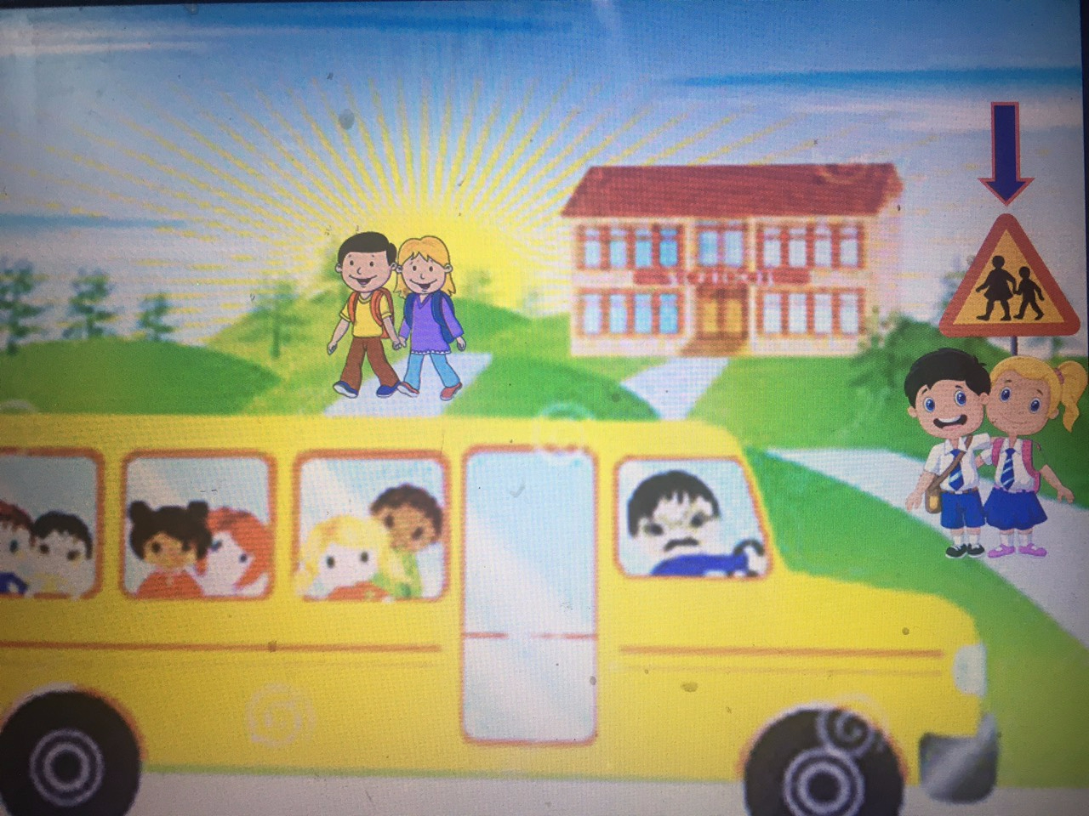
: On my way to school there is a school , so I can see a “school ahead” sign.

Slide 18
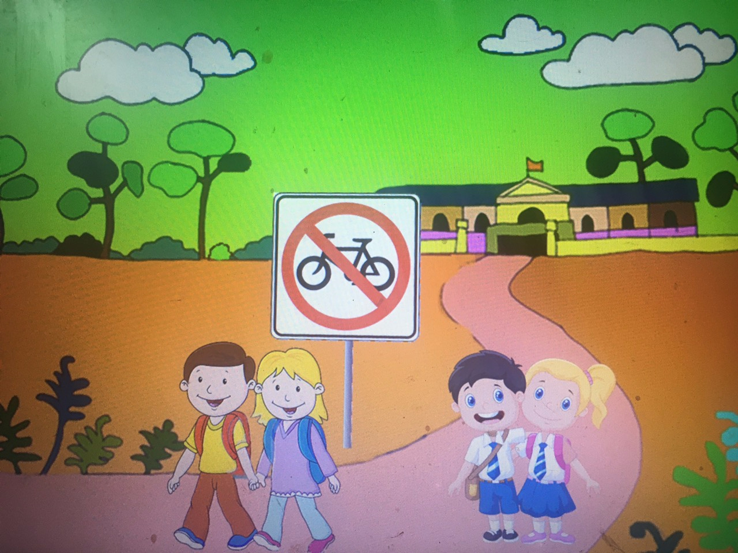
On the way to school, I can see a “no cycling” sign.

Slide 19
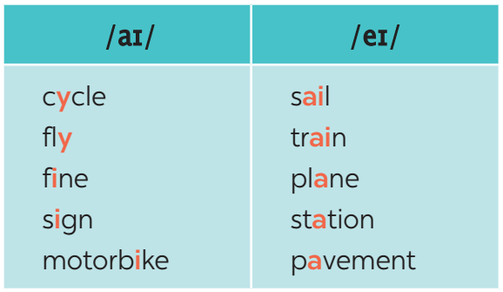
B. PRONUNCIATION
Activity 4: Listen and repeat. Pay attention to the sounds /aɪ/ and /eɪ/.

Slide 20
Activity 5: Underline the words with the sound /aɪ/ and circle the words with the sound /eɪ/. Then listen, check and repeat
The bus station is far from my house.
2. Remember to ride your bike carefully.
3. We must obey traffіc rules for our safety.
4. You have to get there in time for the train.
5. Don’t ride on the pavement.
eɪ
aɪ
aɪ
aɪ
eɪ
eɪ
aɪ
eɪ
aɪ
eɪ

Slide 21
Wrap up: Thiết kế 1 trò chơi
Discuss which of the signs you see on the way to school.
A: On the way to school, I can see a “no right turn” sign.
B: On my way to school there is a hospital, so I can see a “hospital ahead” sign.

Slide 22
Homework
- Learn new words by heart.
- Practice the dialogue again.
- Do exercises in workbook.
- Prepare for Unit 7: Closer look 2.
+

