Slide 2
WARMER:
JUMBLE SENTENCES
Arrange the words so that they can make the meaningful sentence
1. have/ We/ Fridays./ on/ English lesson/ always
→ We always have English lesson on Fridays.
2. having/ We/ now./ English lesson/are
→ We are having English lesson now.

Slide 3
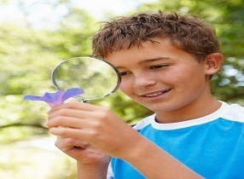
Thursday, November 4 ^{th}, 2021
LESSON 3:
* The present continuous (Thì hiện tại tiếp diễn)

Slide 4
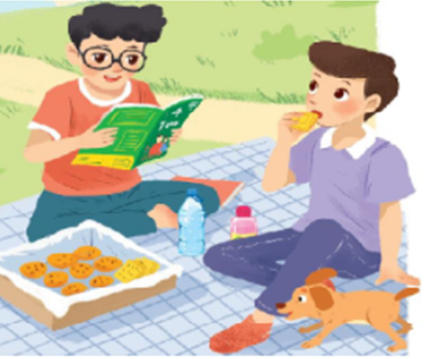
Phong
Nam
The present continuous (Thì hiện tại tiếp diễn)
(+) Positive :
S + am/is/are + V-ing
EX: They are having a picnic now.

Slide 5
Phong
Nam
The present continuous (Thì hiện tại tiếp diễn)
(-) Negative :
S + am not /isn’t/ aren’t + V-ing
Phong is reading books
but he is not eating now.
Nam is eating
but he is not reading now.

Slide 6
Phong
Nam
The present continuous (Thì hiện tại tiếp diễn)
(?) Question
Am/ Is/ Are + S + V-ing?
Yes, S + am/ is/are
No, S + am not/ isn’t/ aren’t.
EX: Are they having a picnic now?
Yes, they are
Is Nam reading now?
No, he isn’t

Slide 7
I. Grammar: The present continuous ( Thì hiện tại tiếp diễn) a. Ex: She is learning English now. She is not learning English now. Is she learning English now? Yes, she is/ - No, she isn’t.
b.Form:
(+) Positive : S + am/is/are + V-ing
(-) Negative : S + am/is/are + not + V-ing
(?) Questions: Am/is/are + S + V-ing ?
Yes, S + am /is /are
No, S + am not/ isn’t / aren’t
c.Use:
To talk about actions happening now.
now, at present, at the moment,
Look! Listen!...
d.Cues:

Slide 8
Phong
Nam
1. They __________ a picnic. (have)
are having
2. Nam __________ books. (not read)
isn’t reading
Is
reading
3. _____ Phong ________ books? (read )

Slide 9
II. Practice: 1.Put the verbs in brackets in the present continuous.
is reading
1.
Nam (read) _________
a book now.
are playing
2.
They (play) ___________
football at the moment.
isn’t making
a sandwich at present.
3.
My sister (not make) ____________
am going
4.
I (go) ________ to the supermarket at the moment.
5.
Are
___they (talk)________about their new friends?
talking

Slide 10
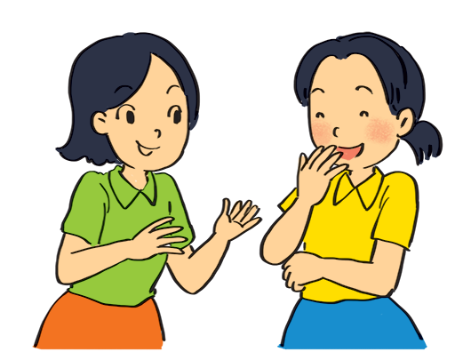
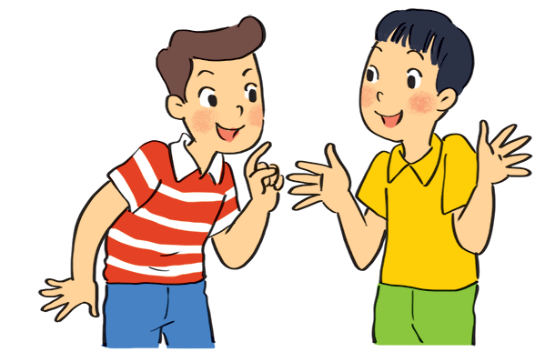
Look at the pictures. Write sentences like the example. Use positive or negative present continuous verbs.
Example:
Lan and Mai (talk)
Nam and Ba(eat ice cream)
Lan and Mai are talking. (talk)
Nam and Ba aren’t eating ice cream

Slide 11
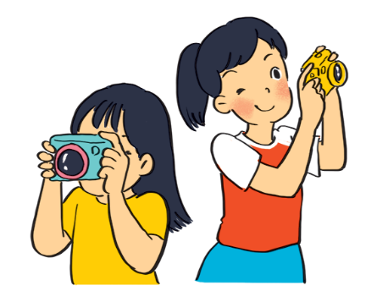
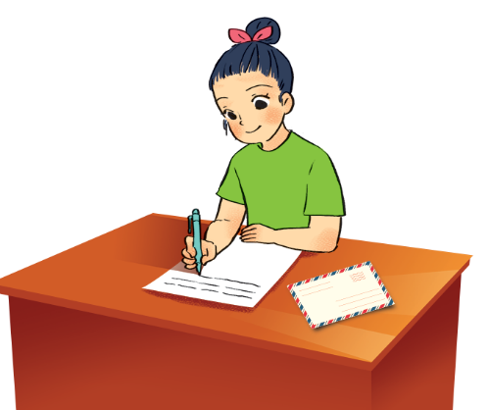
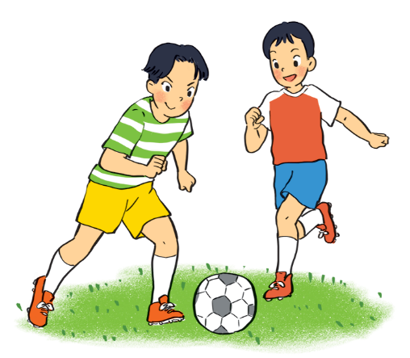
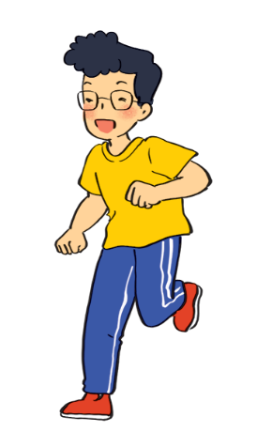
.
1.
aren’t eating ice cream.
Nam and Ba
(eat ice cream)
are taking photos.
2.
Lan and Trang
(take photos)
.
3.
Ha
(write a letter)
is writing a letter.
.
4.
aren’t playing badminton.
Duong and Hung
(play badminton)
.
isn’t drawing a picture.
5.
.
Phong
(draw a picture)

Slide 12
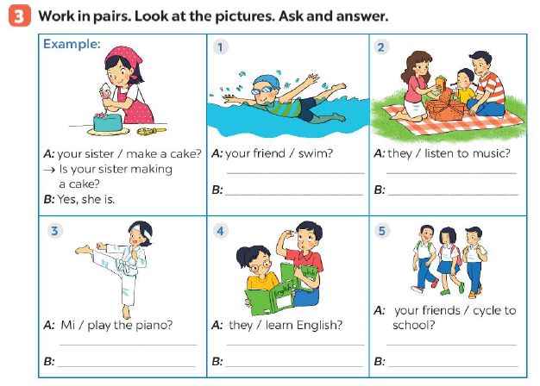

Slide 13
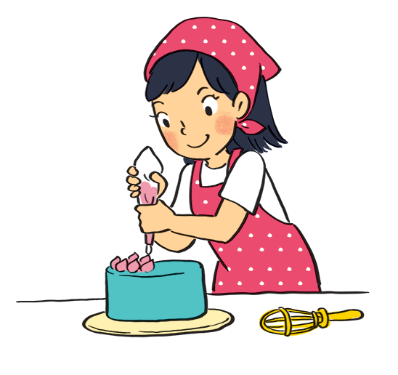
Work in pairs. Look at the pictures. Ask and answer.
Example:
A: your sister / make a cake?
Is your sister making a cake?
B: Yes, she is.

Slide 14
✓
✓
x
x
✓
x

Slide 15
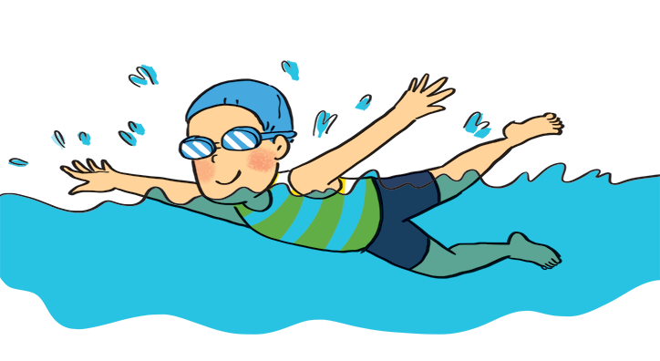
1
A: your friend / swim?
B:
Is your friend swimming?
Yes, he is.

Slide 16
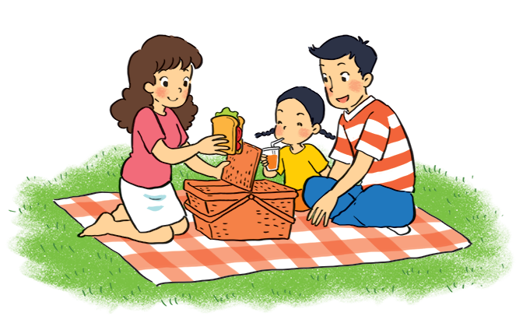
2
A: they / listen to music?
B:
Are they listening to music?
No, they aren’t.
( They are having a picnic.)

Slide 17
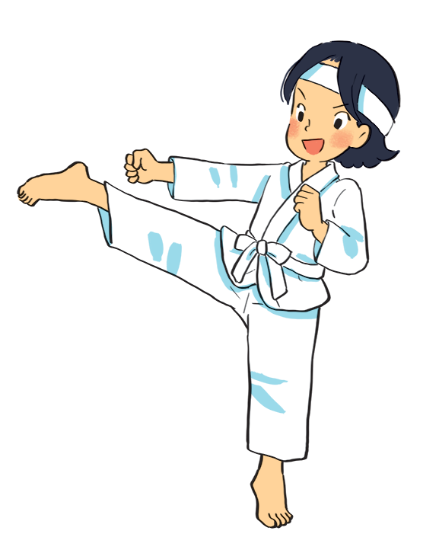
3
A: Mi / play the piano?
B:
Is Mi playing the piano?
No, she isn’t.
( She is doing karate.)

Slide 18
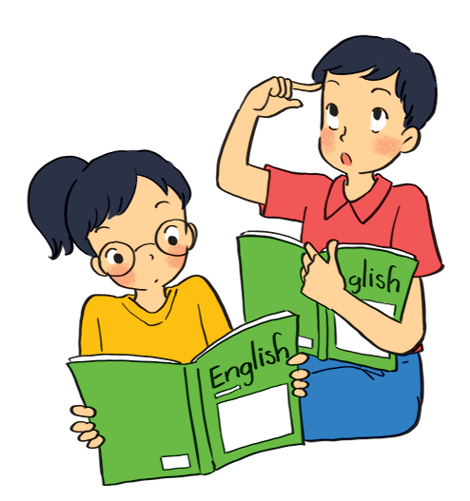
4
A: they / learn English?
B:
Are they learning English?
Yes, they are.

Slide 19
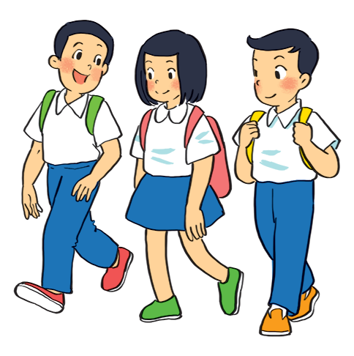
5
A: your friends / cycle to school?
B:
Are your friends cycling to school?
No, they aren’t.
( They are walking to school.)

Slide 20
Put the verbs in brackets in the present simple or present continuous.
My best friend (not walk)
Sometimes she (cycle)
1.
doesnot / doesn’t walk
to school every day.
to school every day.
cycles
2.
he (play) ?
is
playing
Look! What
he (play) ?
your friends (study)
every afternoon?
3.
Do
your friends (study)
study
in the library
in the library
in the library
4.
I (write)
an email to my friend now.
am writing
an email to my friend now.
He (not do)
He (read)
his homework now.
5.
Isn’t doing
his homework now.
is reading.

Slide 21
BACK TO BOARD
?

Slide 22
BACK TO BOARD
Swimming.
Are you running?
Are you swimming?
No, I am not.
Yes, I am.

Slide 23
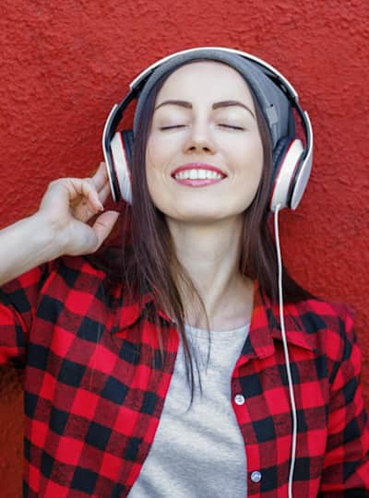
BACK TO BOARD
Listening to music

Slide 24
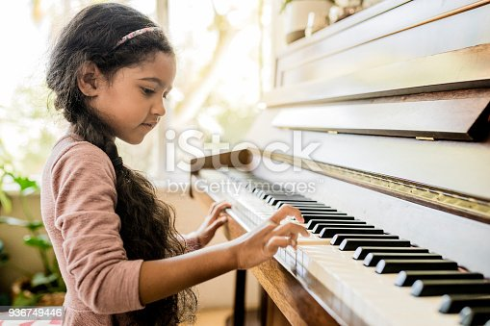
BACK TO BOARD
Playing the piano

Slide 25
BACK TO BOARD
Taking photos

Slide 26
BACK TO BOARD
Playing football

Slide 27
BACK TO BOARD
Walking to school

Slide 28
CONSOLIDATION
Form
Use
PPresent Continuous tense
Cues

Slide 29
HOMEWORK
Write and learn the present continuous by heart
Prepare Communication p.31

Slide 30
THANKS FOR YOUR ATTENTION!
Goodbye!

Slide 31
